Slide 2
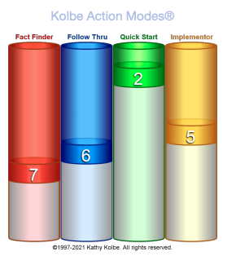
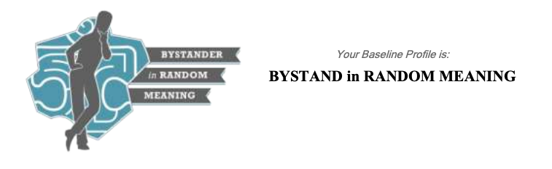
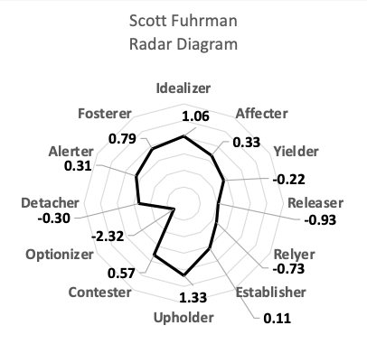
<<name>>’s action instincts are <<Kolbe Overall Score>>. This means he will gather and share information by Specifying. This includes ranking and quantifying, defining objectives and developing complex strategies. He organizes through Maintaining; packaging things together that fit, adjust procedures, coordinating schedules and drafting guidelines. He will deal with risk and uncertainty by Stabilizing; this means he will protect the status quo, clarify deadlines and minimize risk factors. Finally, his best method for tackling space and intangibles is to Restoring; testing ingredients, fixing moving parts and removing both real and imagined obstacles.
Kolbe
His communication patterns are to Bystand in Random Meaning. A Bystander bridges. Bystanders observe, add neutral perspective and integrate seemingly disparate ideas. Bystands connect the elements of the action. Individuals demonstrating the Random propensity operate with no rules and few boundaries. They tend to emphasize creative expression, autonomy and individuality. They rarely consider imposing a system on others - they merely want the freedom to operate in their own unique way. The language of Meaning is about thinking, logic and a sense of purpose. Individuals with a Meaning Propensity are concerned with “what we stand for” and with deeply understanding how things work. They love exploring ideas and concentrating on the theoretical underpinnings of a discussion.
Kanto
He exhibits strong Visionary and low Insight leadership patterns. This manifests as a Fostering theme. “Fostering” energy, meaning he wants to give and care for others, sometimes to his own detriment; and that he will tend not to draw boundaries when he needs to, for fear of harming relationships. He prefers to work in connection with others toward a big vision. He will take what he sees as the highest value “right” approach to this work, sometimes disapproving of approaches he sees as low value. Under pressure, he will default to protecting what he feels strongly about rather than stepping back to weigh all the options.
Archetypes

